Slide 1


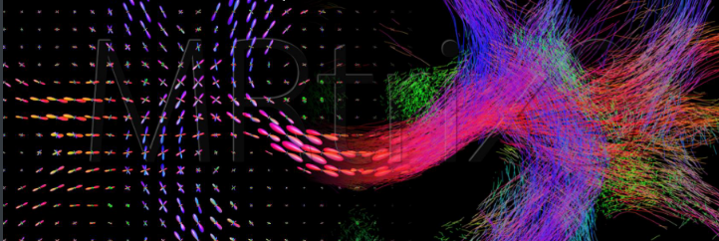
Inbrain Workshop 2023
MRtrix3
Hohana G. Konell

Slide 2
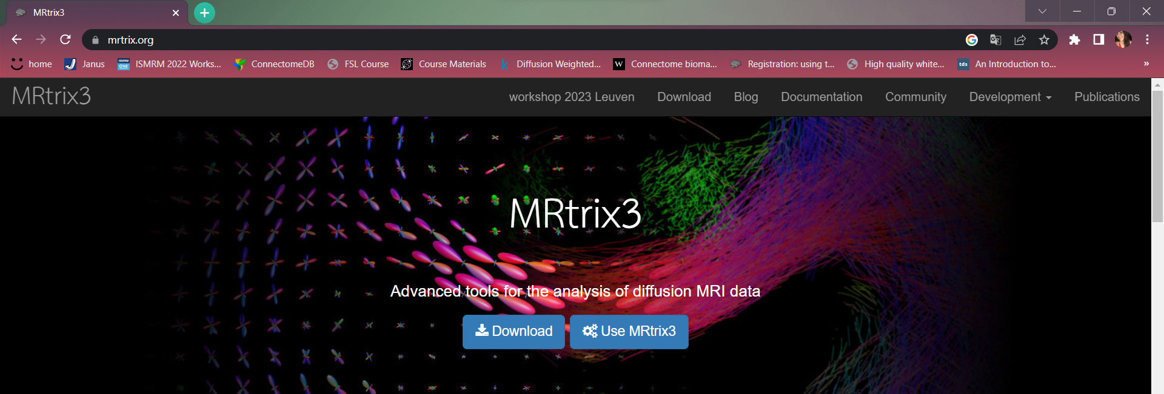
What is MRtrix3?
MRtrix3 provides a set of tools to perform various types of diffusion MRI analyses, from various forms of tractography through to next-generation group-level analyses. It is designed with consistency, performance, and stability in mind, and is freely available under an open-source license. It is developed and maintained by a team of experts in the field, fostering an active community of users from diverse backgrounds.
Tournier, J.-D.; Smith, R. E. 3rd MRtrix3 Worshop.

Slide 3
Diffusion analysis
DATA ACQUISITION
PRE-PROCESSING
VOXEL-LEVEL MODELLING
QUANTIFICATION
ANATOMICAL-PRIORS
REGISTRATION
WHOLE-BRAIN
TRACTOGRAPHY
STATISTICS/GLM
POST-PROCESSING
GROUP TEMPLATE
CONNECTOMICS
VOXEL-BASED ANALYSIS
Tournier, J.-D.; Smith, R. E. 3rd MRtrix3 Worshop.

Slide 4
MRtrix3
Tools for image processing, analysis and visualization, with a focus on the analysis of white matter using diffusion-weighted MRI.
Consistent, well-documented command-line interface
Consistent handling of data
Operations performed in real coordinates where possible
handling of multiple image formats
High performance: C++, multi-threading, OpenGL
Available on all common modern Operating Systems
Many commands support the -h or --help option – This displays help page inline
If in doubt: search online
Tournier, J.-D.; Smith, R. E. 3rd MRtrix3 Worshop.

Slide 5
How is diffusion MRI data stored?
A full dMRI data sets consists of – a 4D image – associated DW encoding information
Each 3D image is a diffusion weighted image characterized by
a diffusion weighting strength or b-value (scalar b)
a diffusion weighting orientation (3D vector [x y z])
This can be stored in many different ways (.nii, .dcm, .mif)
Use associated files: bvecs / bvals – MRtrix3 mif/mih: stored in header
It’s text: you can read it with a text editor
Tournier, J.-D.; Smith, R. E. 3rd MRtrix3 Worshop.
Notes:
This information is stored in the gradient table as lines of [x y z b] • ↑ diffusion along the DW orientation → ↓ signal • ↑ diffusion weighting strength
→ ↑ diffusion contrast

Slide 6
How is diffusion MRI data stored?
bvecs / bvals
bvals: a single row of b-values, one per volume
bvecs: 3 rows of gradient direction coefficients (gradient directions specified relative to image axes)
‘radiological’ storage convention (as per old Analyze format)
LHS coordinate system – transform matrix has negative determinant
not ‘radiological’ (default in NIfTI is neurological…):
need to invert x-component (first row)
Tournier, J.-D.; Smith, R. E. 3rd MRtrix3 Worshop.

Slide 7
Image handling in MRtrix3
All image handling is handled by the MRtrix library – All commands can handle data the same way
Provides a way to access the data in many different formats:
DICOM (single- or multi-frame)
NIfTI (versions 1 & 2)
MGH / MGZ (FreeSurfer)
mif / mih (MRtrix3)
…
But not all data formats are equivalent!
Tournier, J.-D.; Smith, R. E. 3rd MRtrix3 Worshop.

Slide 8
Basic and useful commands
mrinfo: querying the image header
Display relevant header information (dimensions, voxel size, data type, image transform, strides (order of storage), DW encoding, etc.)
mrconvert: convert images
Allows to: convert between formats, convert between data types, change strides, extract ROI or subset of volumes, reduce dimensionality of image, manipulate header entries.
mrstats: get summary statistics
Get mean, median, min, max, … intensity per volume an be supplied with a mask to get statistics within ROI

Slide 9
Basic and useful commands
mrcat: concatenate images
stitch images together along specified axis, create multi-volume image from individual 3D images
mrcalc: voxel-wise calculations
Uses a stack-based syntax: operands (images or values) pushed onto stack, operations consume operands and push their result onto stack
For details, consult help page and/or "introduction to mrcalc" document
mrmath: mean, median, sum, …
compute summary statistics: along image axis (e.g. along volumes) and across images
Tournier, J.-D.; Smith, R. E. 3rd MRtrix3 Worshop.

Slide 10
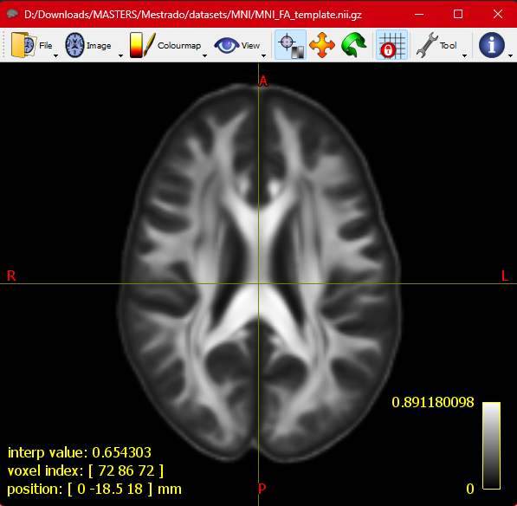
MRView: the MRtrix3 viewer
MRView handles all display operations in scanner coordinates
bottom left corner shows: voxel intensity, voxel index, position in real space
Camera view is by default locked to the image axes
view can change when switching between images - use ‘grid lock’ button to toggle
Tournier, J.-D.; Smith, R. E. 3rd MRtrix3 Worshop.

Slide 11
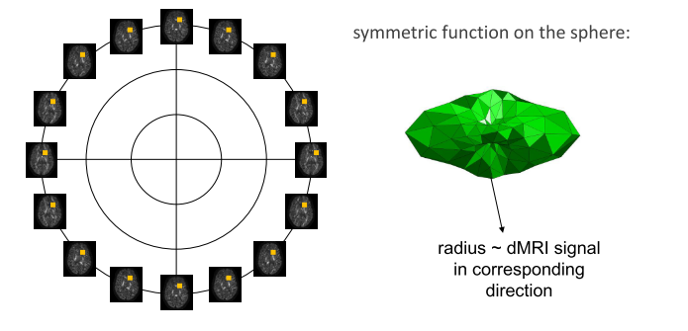
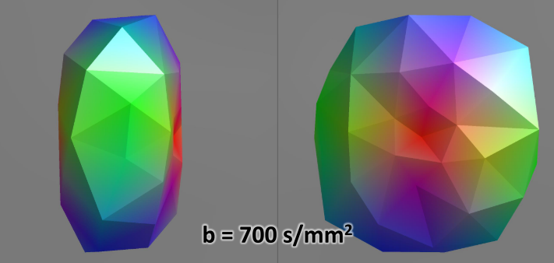
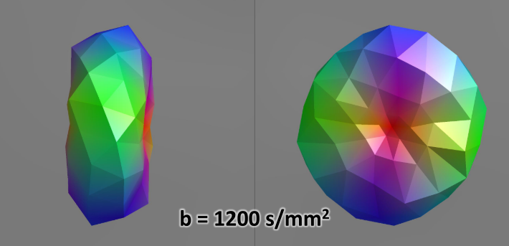
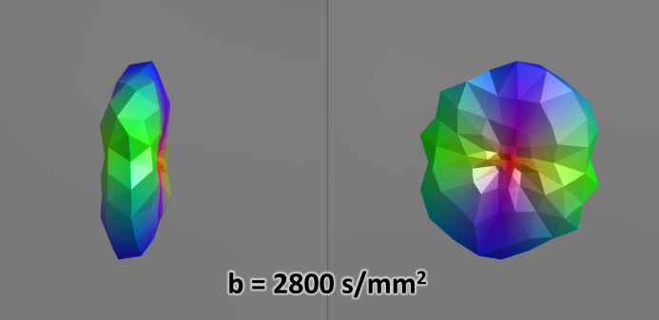
Diffusion signal
$ mrview T1.mif -odf.load_dixel dwi.mif
Tournier, J.-D.; Smith, R. E. 3rd MRtrix3 Worshop.

Slide 12
Importing your data
$ mrconvert data.nii.gz dwi.mif -fslgrad bvecs.bvec bvals.bval -datatype float32 -strides 0,0,0,1
$ mrinfo dwi.mif

Slide 13
The “standard” preprocessing pipeline
1. DENOISING
2. GIBBS RINGING
3. MOTION AND DISTORTION
4. BIAS FIELD
5. BRAIN MASKING
Always check intermediate outputs !!

Slide 14
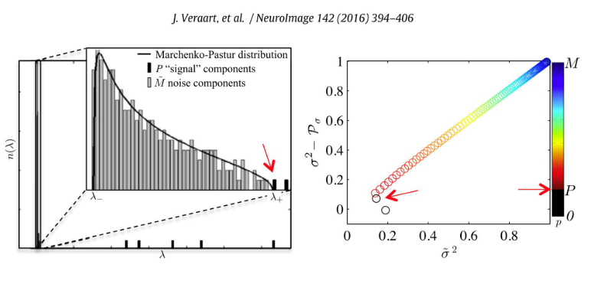
1. Denoising
Main command: dwidenoise
$ dwi2mask dwi.mif - | maskfilter - dilate preproc_mask.mif -npass 5
$ dwidenoise dwi.mif denoise.mif -noise noiselevel.mif -mask preproc_mask.mif
Tournier, J.-D.; Smith, R. E. 3rd MRtrix3 Worshop.
Notes:
dMRI noise level estimation, melhorar a relaçao sinal ruido
preserve only the signal-carrying principal components
Lambda autovalor

Slide 15
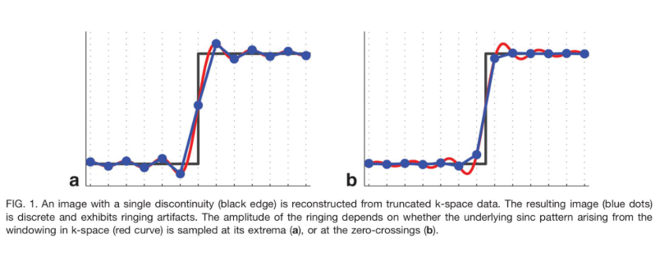
2. Gibbs ringing correction
Main command: mrdegibbs
Kellner et al., MRM, 2016
$ mrdegibbs denoise.mif degibbs.mif
Tournier, J.-D.; Smith, R. E. 3rd MRtrix3 Worshop.
Notes:
Gibbs artifact, also known as truncation artifact or ringing artifact, is a type of MRI artifact. It refers to a series of lines in the MR image parallel to abrupt and intense changes in the object at this location, such as the CSF-spinal cord and the skull-brain interface.

Slide 16
3. Motion & distortion correction
Main command: dwifslpreproc
Geometry correction for 3 sources of EPI artefacts:
Subject motion (rigid translation / rotation in between image volumes)
Eddy-current induced distortion (low-frequency distortion along phase encoding direction)
Magnetic field susceptibility induced distortion (distortions along phase encoding direction; strongest at tissue interfaces)
$ dwifslpreproc -rpe_none -pe_dir AP degibbs.mif geomcorr.mif
Tournier, J.-D.; Smith, R. E. 3rd MRtrix3 Worshop.

Slide 17
4. B1 bias field correction
Main command: dwibiascorrect
B1 modulation causes intensity modulation
Multiplicative bias field
Blurring the frequency content
Not usually considered an issue in dMRI, since “traditional” DWI analyses normalize to b=0
Correction strategy: – FSL fast based on brain segmentation – ANTs N4 (no priors) fits smooth bias field that maximizes frequency content
$ dwibiascorrect fsl geomcorr.mif biascorr.mif -bias biasfield.mif

Slide 18
5. Brain masking
Main command: dwi2mask
Brain mask speeds up subsequent analysis
MRtrix includes heuristic segmentation script dwi2mask
FSL bet can also be useful
$ dwi2mask dwi.mif mask.mif
Tournier, J.-D.; Smith, R. E. 3rd MRtrix3 Worshop.

Slide 19
Aligning T1w to DWI
Multi-modal registration, e.g., using mutual information
Use FSL flirt
$ dwiextract dwi.mif -bzero - | mrmath -axis 3 - mean b0.nii
$ flirt -dof 6 -cost normmi -in raw/T1w -ref b0 -omat T_fsl.txt
$ transformconvert T_fsl.txt raw/T1w.nii.gz b0.nii flirt_import T_T1toDWI.txt
$ mrtransform -linear T_T1toDWI.txt raw/T1w.nii.gz T1w.nii.gz

Slide 20
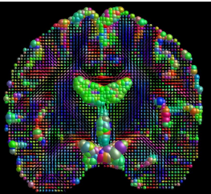
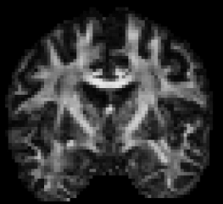
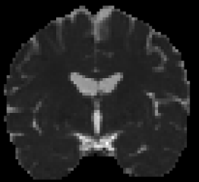
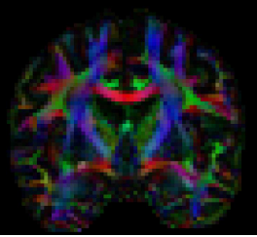
Voxel level modelling
Diffusion-Weighted Image:
Contrast is affected by a combination of different factors
some intrinsic to the tissue
some dependent on the experimental settings
measurement by itself only qualitative/relative (not absolute)
Aim of voxel-level modelling:
Extract quantitative (reproducible) metrics about diffusion/tissue from a series of diffusion-weighted images with different experimental settings.
Tournier, J.-D.; Smith, R. E. 3rd MRtrix3 Worshop.

Slide 21
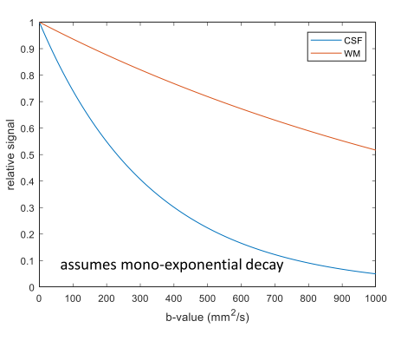
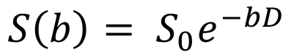
Apparent diffusion coefficient (ADC)
If water molecules encounter hindrances along their random walk, their mean squared displacement per unit time (apparent diffusion coefficient) will be lower than when observed in ‘free’ water.
$$S\left(b\right)= S_{0}e^{−bD}$$
Tournier, J.-D.; Smith, R. E. 3rd MRtrix3 Worshop.

Slide 22
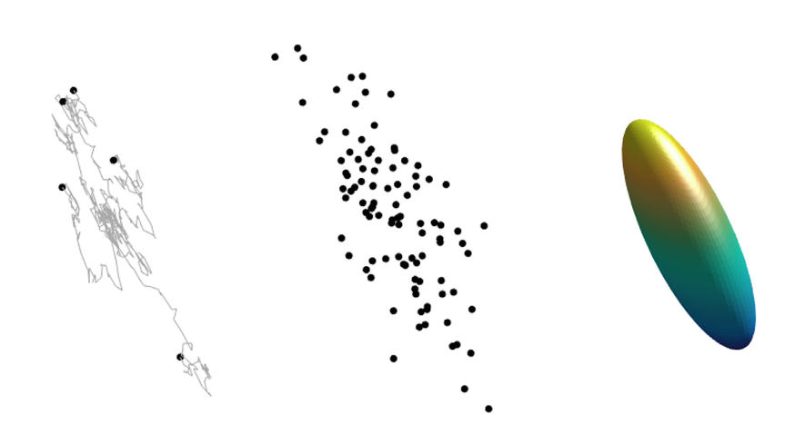
Diffusion tensor imaging
diffusion tensor represented as an ‘ellipsoid’ (isoprobability surface of diffusion PDF)
$ dwi2tensor -mask mask.mif dwi.mif tensor.mif
Tournier, J.-D.; Smith, R. E. 3rd MRtrix3 Worshop.

Slide 23
Diffusion metrics
fractional anisotropy (FA)
$tensor2metric tensor.mif -fa fa.mif
apparent diffusion coefficient (ADC)
mean diffusivity (MD)
$tensor2metric tensor.mif -adc md.mif
Tournier, J.-D.; Smith, R. E. 3rd MRtrix3 Worshop.

Slide 24
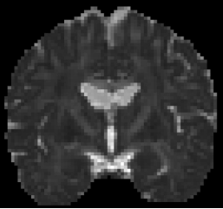
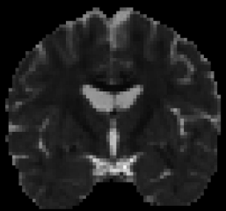
Diffusion metrics
axial diffusivity (AD)
$tensor2metric tensor.mif -ad ad.mif
radial diffusivity (RD)
$tensor2metric tensor.mif -rd rd.mif
Tournier, J.-D.; Smith, R. E. 3rd MRtrix3 Worshop.

Slide 25
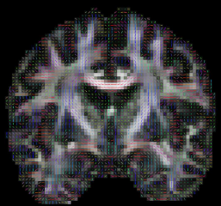
Diffusion metrics
principal diffusion vector (PDV)
$tensor2metric dt.mif -vector dt_ev.mif
directionally encoded color (DEC) FA
$tensor2metric dt.mif -vector dt_ev.mif
Tournier, J.-D.; Smith, R. E. 3rd MRtrix3 Worshop.

Slide 26
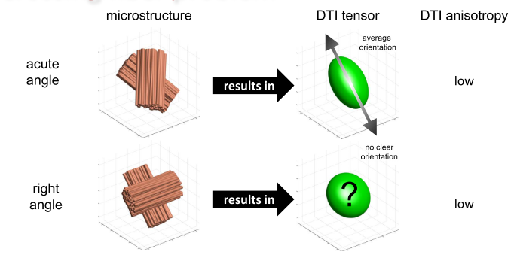
Crossing fiber problem
Tournier, J.-D.; Smith, R. E. 3rd MRtrix3 Worshop.

Slide 27
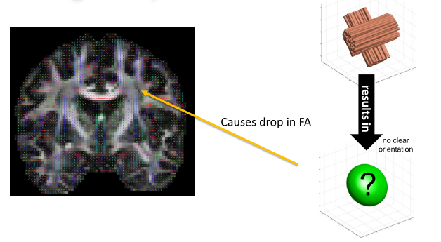
Crossing fiber problem
Tournier, J.-D.; Smith, R. E. 3rd MRtrix3 Worshop.

Slide 28
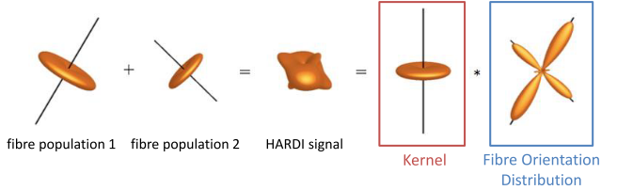
How can we model crossing fibers?
Let’s build a forward model first:
Assume that WM fibers along a single axis have a fixed and equal contribution to the dMRI signal (response function or kernel)
Assume no exchange between fiber compartments, such that the signal is the sum of the kernels of all fiber populations
General form: ‘infinite sum’ of the response == spherical convolution
Goal: solving the inverse problem == spherical deconvolution
Tournier, J.-D.; Smith, R. E. 3rd MRtrix3 Worshop.

Slide 29
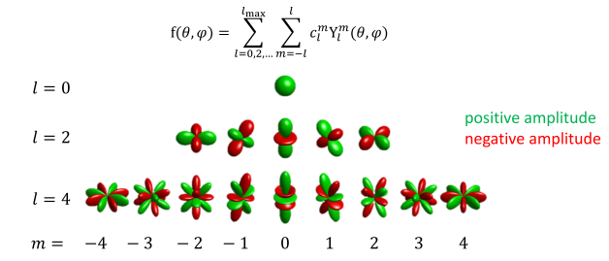
Spherical harmonics
Efficient representation for signals on the sphere (single-shell HARDI)
Represent symmetric signal as linear combination of SH basis functions
Efficient expression of spherical convolution as multiplication of corresponding SH coefficients !
Symmetric functions on the sphere can be represented as a linear combination of symmetric spherical harmonics (SH) basis functions:
Tournier, J.-D.; Smith, R. E. 3rd MRtrix3 Worshop.

Slide 30
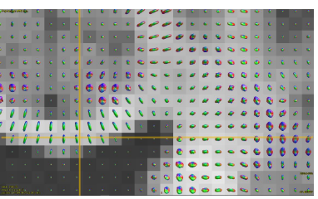
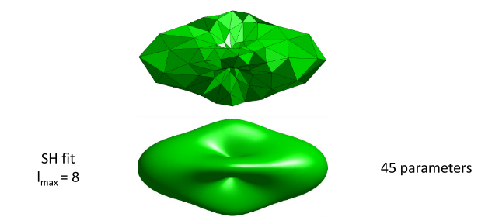
Spherical harmonics
Single-shell dMRI signal represented by truncated series of SH basis functions:
$amp2sh dwi.mif sh.mif (one b value)
$amp2sh dwi.mif –shell 3000 sh_3000.mif (multiple b values)
Tournier, J.-D.; Smith, R. E. 3rd MRtrix3 Worshop.

Slide 31
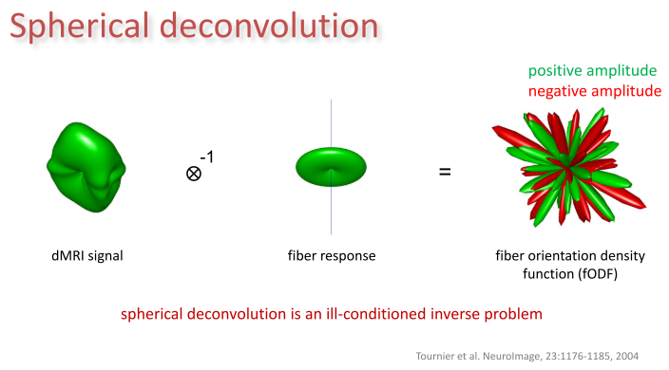
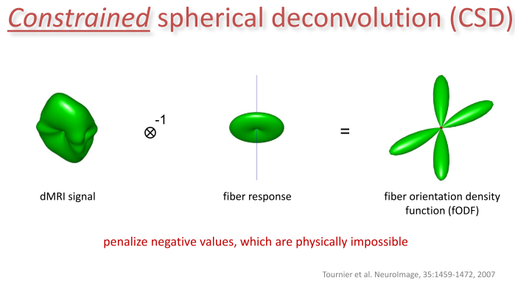
Constrained Spherical Deconvolution
When expressed in the SH basis, the math becomes very simple…
but the optimization (solving the inverse problem) is not (regularization or constraint)
Spherical deconvolution
Constrained spherical deconvolution
Tournier, J.-D.; Smith, R. E. 3rd MRtrix3 Worshop.

Slide 32
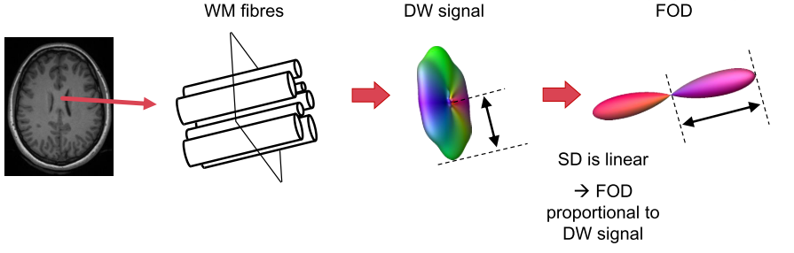
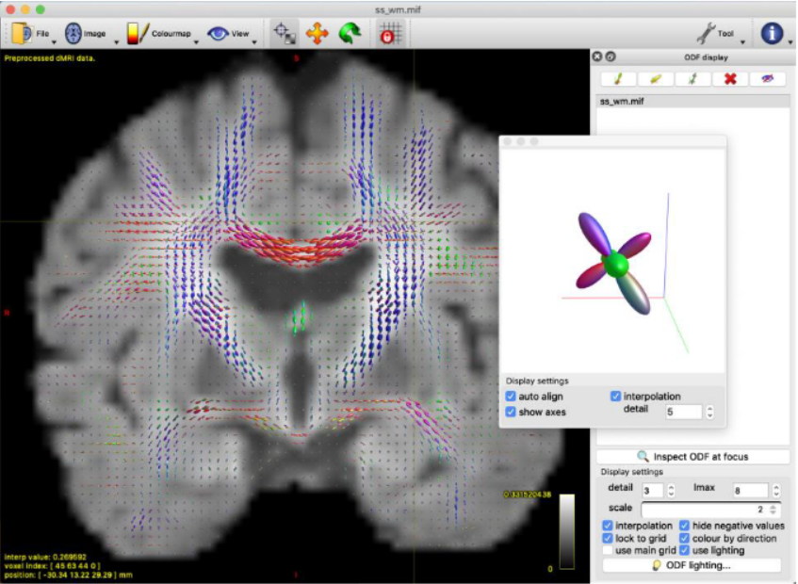
Constrained Spherical Deconvolution
$dwi2fod csd –mask mask.mif dwi.mif wm.txt fod_wm.mif
Tournier, J.-D.; Smith, R. E. 3rd MRtrix3 Worshop.

Slide 33
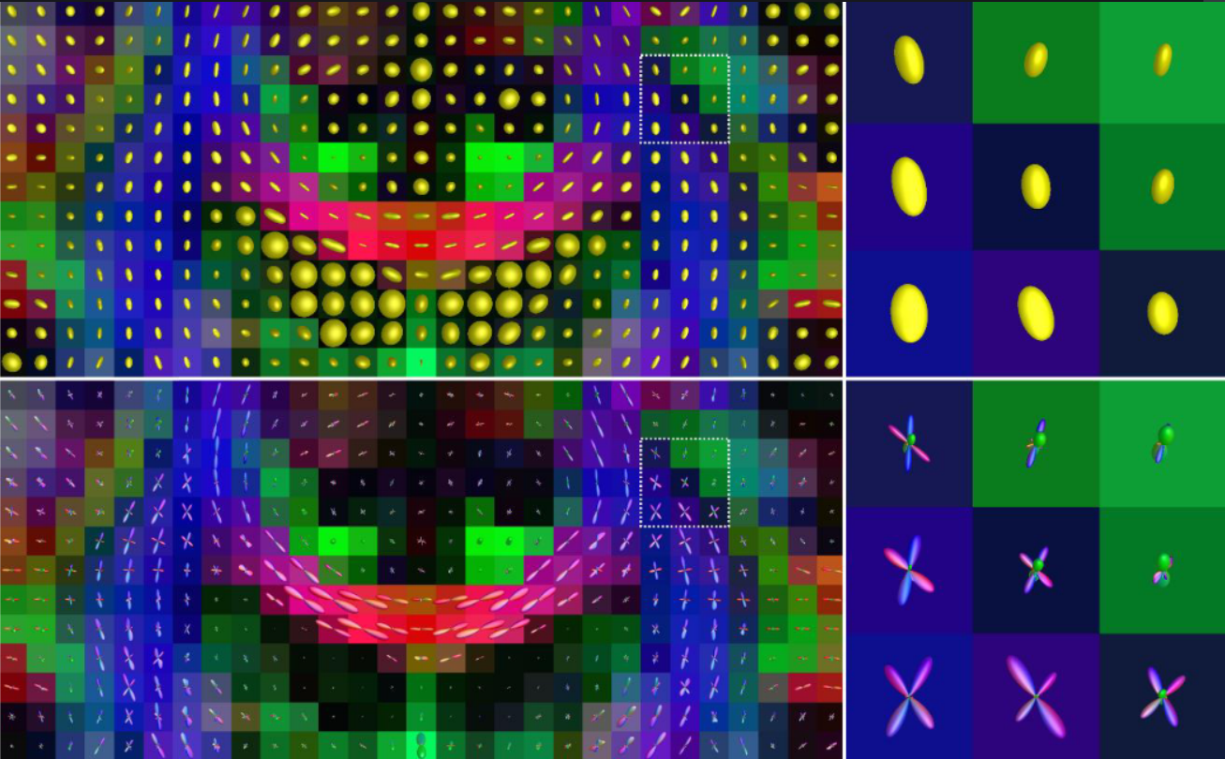
DTI vs CSD
Tournier, J.-D.; Smith, R. E. 3rd MRtrix3 Worshop.
Notes:
DTI oversimplifies : not resolve crossing fibers and multiple compartments
CSD improvement : resolves crossing fibers bur not partial volume effects with GM and CSF

Slide 34
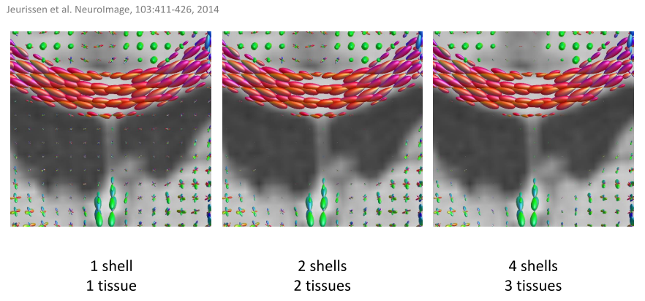
Multi-tissue CSD: 1-tissue vs 2-tissue vs 3-tissue CSD
Tournier, J.-D.; Smith, R. E. 3rd MRtrix3 Worshop.
Notes:
DTI oversimplifies : not resolve crossing fibers and multiple compartments
CSD improvement : resolves crossing fibers bur not partial volume effects with GM and CSF

Slide 35
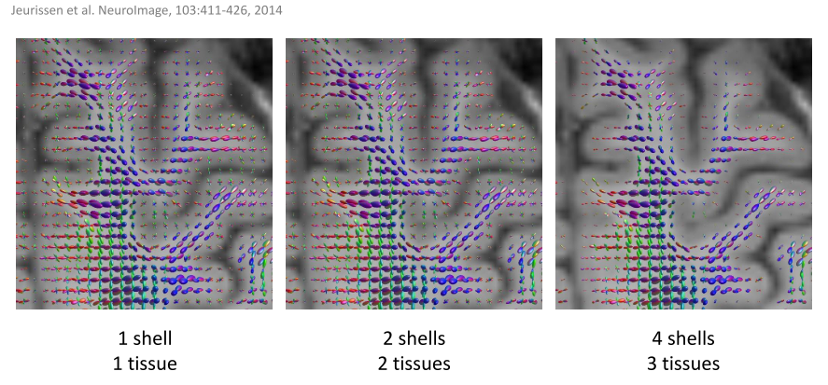
Multi-tissue CSD: 1-tissue vs 2-tissue vs 3-tissue CSD
Tournier, J.-D.; Smith, R. E. 3rd MRtrix3 Worshop.
Notes:
DTI oversimplifies : not resolve crossing fibers and multiple compartments
CSD improvement : resolves crossing fibers bur not partial volume effects with GM and CSF
MT-CSD : resolves multiple compartments

Slide 36
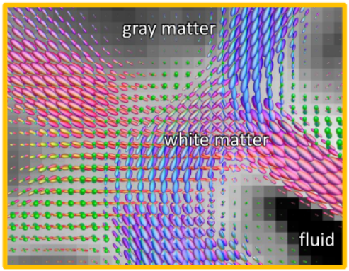
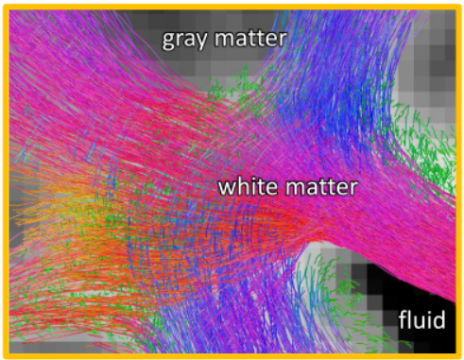
Tractography
amount of white matter fibers as a function of orientation
white matter fiber connections
Tournier, J.-D.; Smith, R. E. 3rd MRtrix3 Worshop.

Slide 37
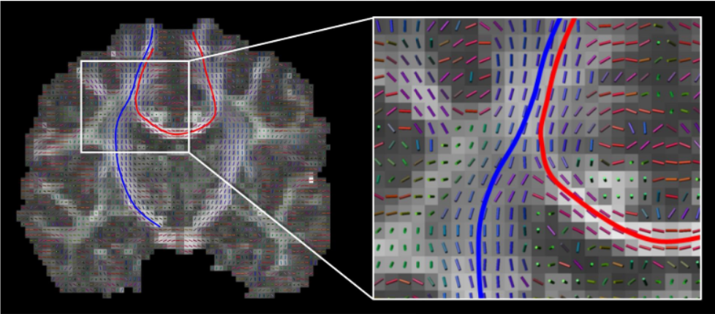
Streamline tractography
local fiber orientations = vector field → fiber tracks = streamlines
Tournier, J.-D.; Smith, R. E. 3rd MRtrix3 Worshop.

Slide 38
Tractography
diffusion tensor
1. LOCAL MODELLING
fODFs
Euler
2. INTEGRATION METHODS
Runge-Kutta
nearest
3. INTERPOLATION METHODS
linear/cubic
ROI-based
4. SEED POINT SELECTION
whole-brain
fiber probability < threshold
5. TRACK TERMINATION CRITERIA
local curvature > threshold
inclusive ROIs
6. TRACK EDITING
exclusive ROIs
deterministic : same trajectory
7. DETERMINISTIC AND PROBABILISTIC
probabilistic : distribution
Tournier, J.-D.; Smith, R. E. 3rd MRtrix3 Worshop.

Slide 39
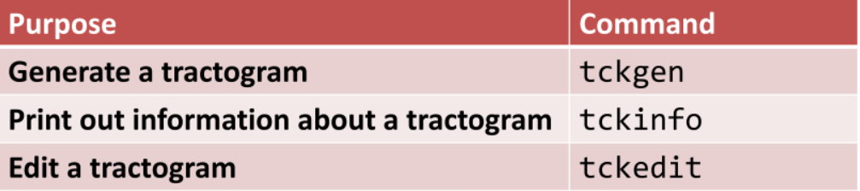
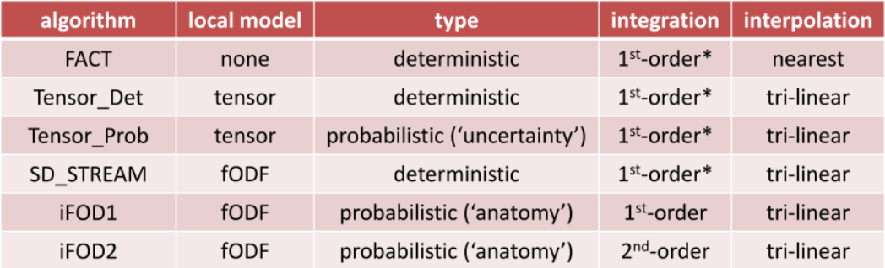
Tractography
$ tckgen –algorithm iFOD2 fod_wm.mif -seed_image mask.mif -select 100K ifod2.tck
Tournier, J.-D.; Smith, R. E. 3rd MRtrix3 Worshop.

Slide 40
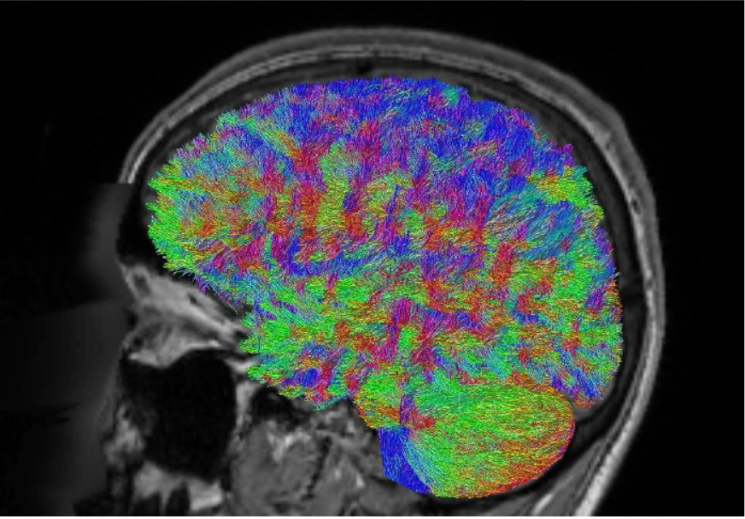
Whole-brain tractography
$ tckgen –algorithm iFOD2 fod_wm.mif -seed_image mask.mif -select 100K ifod2.tck
Tournier, J.-D.; Smith, R. E. 3rd MRtrix3 Worshop.

Slide 41
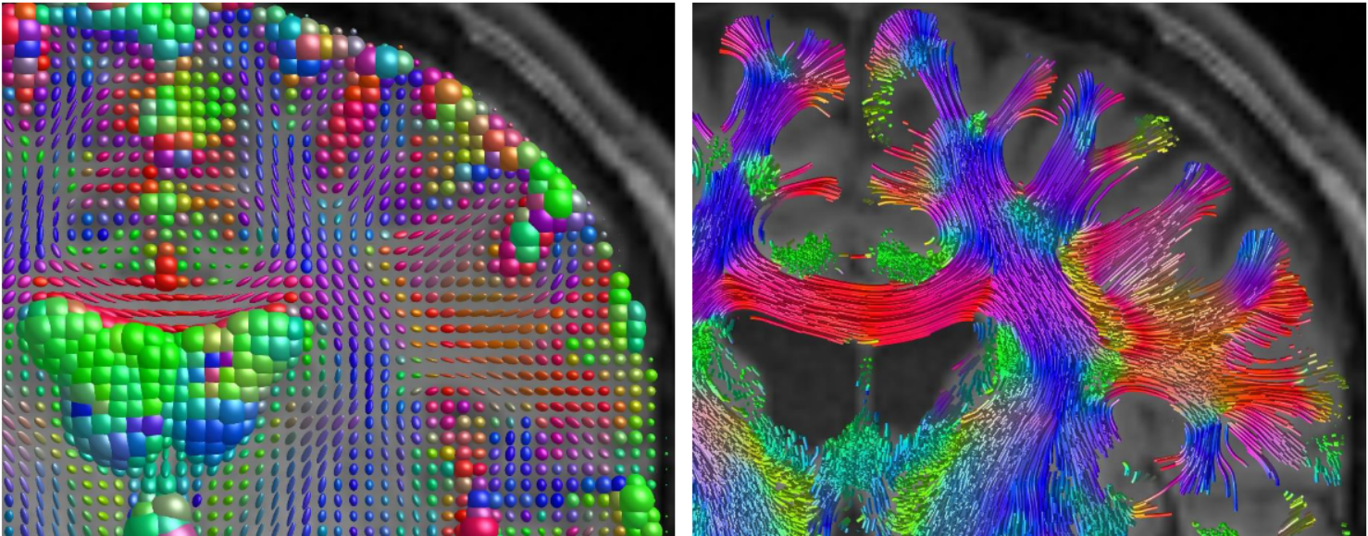
Whole-brain tractography - DTI
$ tckgen dwi.mif dti.tck -select 100K -algo tensor_det -seed_image mask.mif -mask mask.mif -angle 60
Tournier, J.-D.; Smith, R. E. 3rd MRtrix3 Worshop.

Slide 42
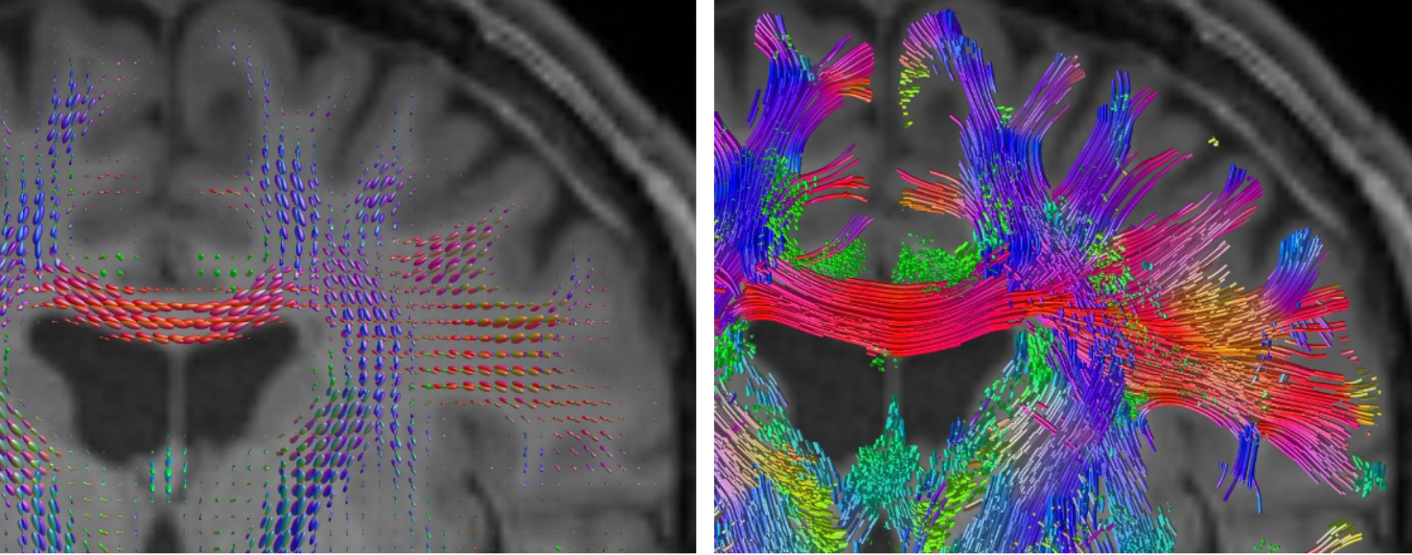
Whole-brain tractography - CSD
$ tckgen fod_wm.mif csd.tck -select 100K -algo sd_stream -seed_image mask.mif -mask mask.mif -angle 60
Tournier, J.-D.; Smith, R. E. 3rd MRtrix3 Worshop.

Slide 43
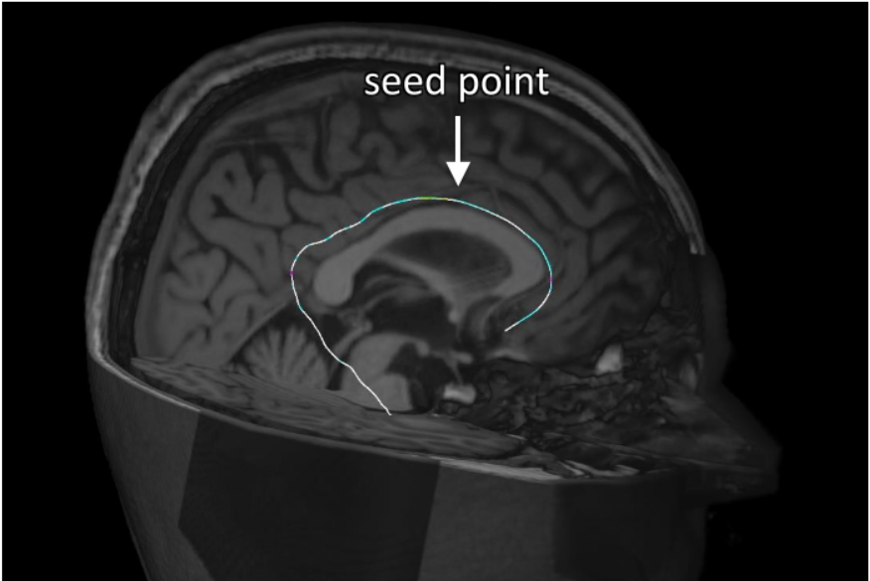
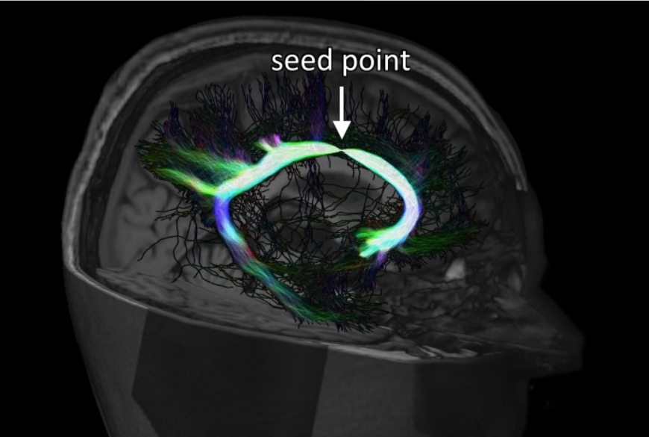
Deterministic vs Porbabilistic
deterministic
probabilistic
$ tckgen fod_wm.mif csd.tck -select 100K -algo FACT -seed_image mask.mif -mask mask.mif -angle 60
$ tckgen fod_wm.mif csd.tck -select 100K -algo iFOD2 -seed_image mask.mif -mask mask.mif -angle 60
Tournier, J.-D.; Smith, R. E. 3rd MRtrix3 Worshop.

Slide 44
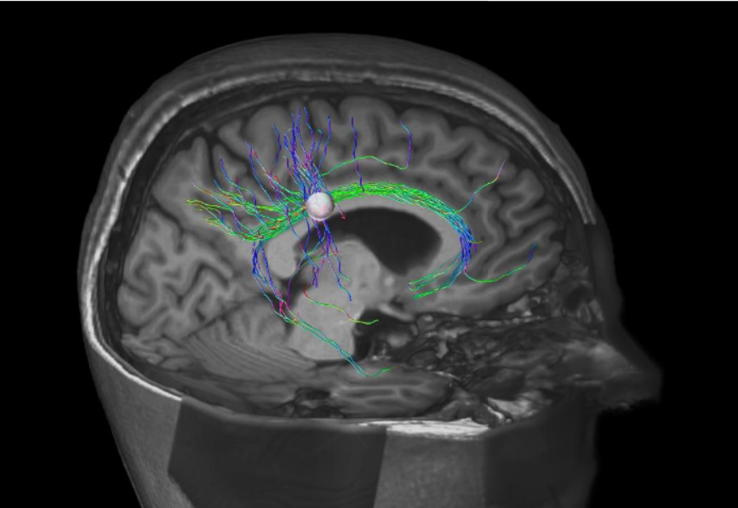
ROI-based tracking: spheres
$ tckgen –algorithm iFOD2 fod_wm.mif -seed_sphere 4,5,24,5 -select 100K cing.tck
Tournier, J.-D.; Smith, R. E. 3rd MRtrix3 Worshop.

Slide 45
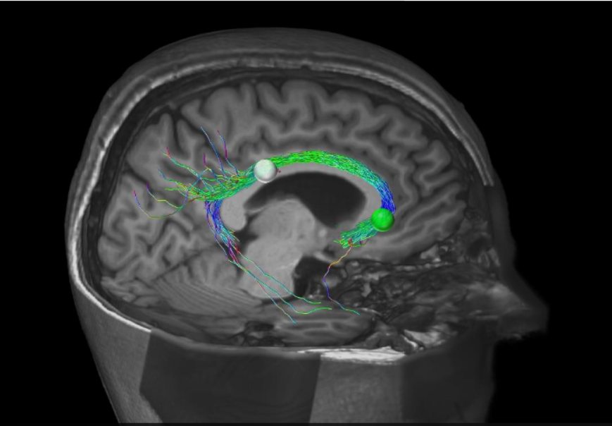
ROI-based tracking: spheres
$ tckgen –algorithm iFOD2 fod_wm.mif -seed_sphere 4,5,24,5 –include 4,44,-6,5 -select 100K cing.tck
Tournier, J.-D.; Smith, R. E. 3rd MRtrix3 Worshop.

Slide 46
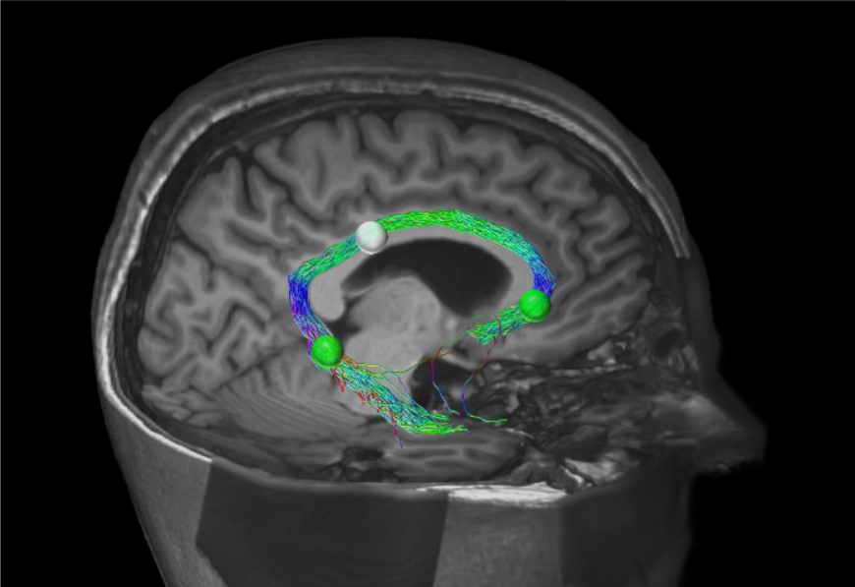
ROI-based tracking: spheres
$ tckgen –algorithm iFOD2 fod_wm.mif -seed_sphere 4,5,24,5 –include 4,44,-6,5 –include 14,-4,-16,5 -select 100K cing.tck
Tournier, J.-D.; Smith, R. E. 3rd MRtrix3 Worshop.

Slide 47
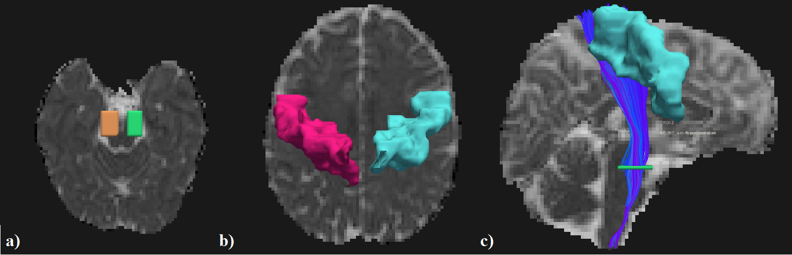
Virtual dissecation: mask ROIs
a) Cerebral peduncle in the midbrain area, axial slice; b) Precentral gyrus/primary motor cortex, axial slice; c) Reconstructed CST tract, sagittal view.
$ tckedit tract.tck –include ROI01.mif –include ROI02.mif CST.tck
Images from Maíra S. Pinto

Slide 48
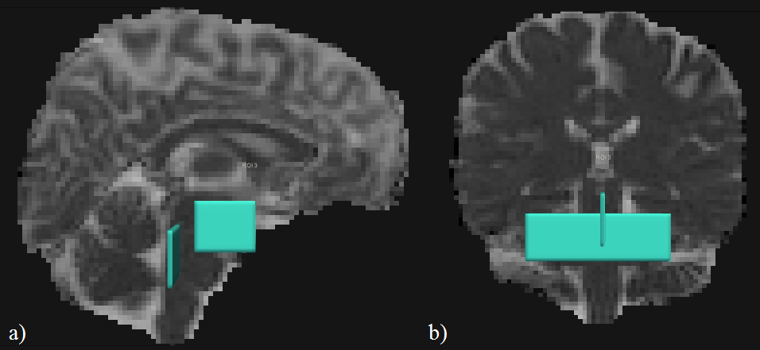
Virtual dissecation: mask ROIs
Exclusion ROIs for the CST tracts: a) ROI selection blocking any fiber to cross the hemispheres, in the middle sagittal slice; b) ROI selection of fibers near the cerebral peduncle that are not part of the CST tract, in the coronal slice. Using the operator NOT for ROI filter for all the drawn ROIs.
$ tckedit CST.tck –exclude NOT01.mif –exclude NOT02.mif CST_new.tck
Images from Maíra S. Pinto

Slide 49
www.inbrainlab.com
hohana.konell@usp.br
OBRIGADA/THANK YOU!!

